Slide 1


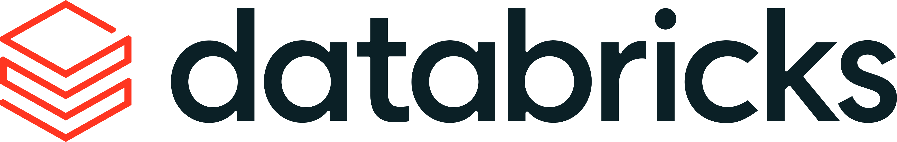

Databricks –
Service Catalogue
Comprehensive List Of Mastech Service Offerings in Databricks

Slide 2

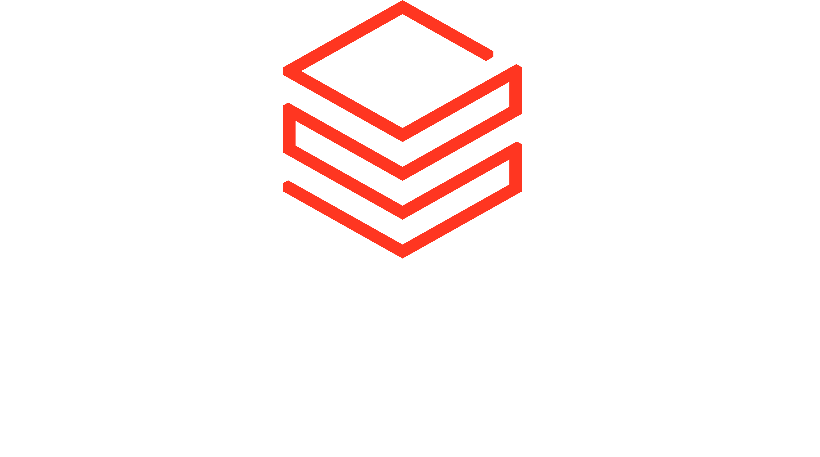




Autonomous Intelligence Practice
Service Catalogue
Data Strategy & Advisory
Data Engineering
Data Governance
Data Analytics & BI
Data Science, AI/ML
Operations & Managed Services
Platform Modernization
Autonomous Intelligence Practice
Intelligent Agent Apps
[Task Automation | Orchestration | Industry LLMs]
Trusted Data Foundation for AI
[Lakehouse | Governance | Analytics]
Managed Autonomous Operations
[Data Ops | ML Ops | LLM Ops | Agent Ops]

Slide 3
Autonomous Intelligence Practice
Service Catalogue
Platform Modernization
Autonomous Data Engineering
Autonomous Data Science
Accelerated AI-native migration from legacy systems to Databricks platform
Autonomous Platform Operations
Managed Services Plus
A comprehensive framework across end-to-end data journey with each phase orchestrated by AI agents working with strategic human intervention at critical decision points to ensure business compliance.
A comprehensive 8-dimensional framework for operationalizing the Databricks Lakehouse platform through autonomous, intelligent agents that observe, reason, and act across eight critical operational domains.
A modern autonomous managed service offering in Databricks leverages AI agents to automate the entire lifecycle of data and AI operations, from pipeline creation to deployment and continuous optimization
Autonomous data science in Databricks is an intelligent, self-operating system where AI agents plan, execute, and refine complete analytical workflows from a single prompt

Slide 4
Platform Modernization
Accelerated AI-native migration from legacy systems to Databricks platform

Slide 5
Platform Modernization
Source Platform | Platform Type | Est. Migration Volume | Market Share % (Est. of Migrations)*
Hadoop (Cloudera / Hortonworks) | Legacy Big Data (On-Prem) | Very High | ~35-40%
Teradata | Legacy EDW (On-Prem) | High | ~20-25%
Snowflake | Cloud Data Warehouse | High (Growing) | ~15-20%
Oracle Exadata | Legacy RDBMS (On-Prem) | Medium | ~10-15%
AWS Redshift | Cloud Data Warehouse | Medium | ~5-10%
SQL Server | Legacy RDBMS | Low-Medium | ~5%
Google BigQuery | Cloud Data Warehouse | Low | <5%
Source ETL Tool | Tool Type | Est. Migration Volume | Market Share % (Est. of Migrations)*
Informatica PowerCenter | Enterprise ETL (On-Prem) | Very High | ~30-35%
SSIS | Mid-Market ETL | High | ~20-25%
IBM DataStage | Enterprise ETL (Mainframe) | Medium-High | ~15%
SAS (Data Management) | Analytics/ETL | Medium | ~10-15%
Ab Initio | High-End ETL | Low (Volume) / High (Value) | ~5-10%
Oracle Data Integrator (ODI) | ELT (DB Centric) | Medium | ~5-8%
Talend (Legacy / On-Prem) | Open Core ETL | Low | <5%

Slide 6
Data Engineering & Governance
Platform Migration
Source Profiler
ETL Code Converter
Migration Factory
Validation Kit
Extract metadata using PDCR, forecast DBU, TCO & Capacity Planning
Automated ETL Conversion from legacy tools to Databricks
Parallel wave-based migration (discovery → assess → convert → validate → cutover)
Automated row count reconciliation, schema validation, query result comparison
Doc Generator
Data Quality Agent
Extract metadata using PDCR, forecast DBU, TCO & Capacity Planning
Automated ETL Conversion from legacy tools to Databricks
40-60%
3-5x
70-85%
6-9
Infrastructure Cost Reduction
Query Performance Improvement
Automated Code Conversion
Migration Timeline
(Months)
Licensed EDW → Consumption-based Databricks
Using Photon engine
Vs. manual rewrite
For 100-200 tables
Pricing Model: Fixed-fee per system/database OR outcome-based (% of cost savings Year 1)

Slide 7
Service Offerings
Autonomous Data Engineering
A comprehensive framework with each phase of data journey orchestrated by AI agents with strategic human intervention at critical decision points to ensure business compliance.

Slide 8
Data Engineering & Governance
Autonomous Data Lakehouse
Data Profiling Agent
Ingestion Agent (Bronze)
Transformation Agent (Silver)
Aggregation Agent (Gold)
Transforms data through cleansing, deduplication, and standardization. Generates code autonomously for common patterns and evolving quality checks
Creates business-ready aggregated datasets for analytics. Automatically selects optimal partitioning, indexing, and storage strategies from access patterns
Automatically discovers and profiles all data assets, analyzing statistical properties, distributions, and metadata across tables
Orchestrates multi-source data ingestion with automatic schema evolution, lineage and metadata tracking and management
Data Quality Agent
Access Control Agent
Lineage & Metadata Agent
Observability Agent
Continuously monitors freshness and completeness using AI-powered anomaly detection and adaptive thresholds
Implements least-privilege access using centralized governance. Automatically manages permissions based on roles, data sensitivity, and compliance needs.
Automatically tracks data lineage through medallion layers. Maintains metadata for tracing data origin and understanding transformations
Tracks agent inputs, outputs, and decisions using MLflow. Monitors all interactions, capturing model usage, tool invocations, and data access patterns.

Slide 9
Data Engineering & Governance
Autonomous Data Lakehouse
Organizations implementing this autonomous approach report significant productivity gains while maintaining proper governance controls. The unified platform enables teams to move from concept to production quickly without tedious trial-and-error experimentation.
50%
Zero
Auto
Faster Task Completion
Tool Fragmentation
Cost Optimization
Reduction in data engineering workflow completion time
Unified governance framework eliminates stitching separate tools
Agent Bricks framework automatically optimizes for cost and quality

Slide 10
Trusted Data Foundation
Managed Lakehouse Operations
Autonomous PlatformOps
A comprehensive 8-dimensional framework for operationalizing the Databricks Lakehouse and Mosaic AI platform through autonomous, intelligent agents that observe, reason, and act across eight critical operational domains.

Slide 11
Managed Operations
Autonomous PlatformOps
InfraOps - Cluster lifecycle, workspace management, network / security, SLAs, scaling patterns
DataOps - Autoloader, ingestion quality, schema drift management, DLT exceptions.
GovernanceOps - Unity Catalog, lineage, data sharing controls, policy enforcement
PipelineOps - ETL/ELT reliability, job orchestration, error triaging, CI/CD
MLOps - Model registry, feature store, training pipelines, monitoring drift.
AgentOps - AI agents for diagnostics, decisioning, remediation and orchestration.
FinOps - Cost baselines, forecasting, chargeback, auto-optimizations
UserOps - User onboarding, workspace experience, productivity metrics.
PlatformOps
InfraOps
DataOps
PipelineOps
AgentOps
GovernanceOps
FinOps
MLOps
UserOps

Slide 12
Service Offerings
Autonomous Data Science
A comprehensive framework with each phase of data journey orchestrated by AI agents with strategic human intervention at critical decision points to ensure business compliance.

Slide 13




Let's build your
50+ Enterprise Implementations
autonomous enterprise
together.
Thanks
mit-presales@mastechdigital.com
Contact us to discuss how our Databricks practice can deliver 2x, 5x, or 10x value for your organization.

Slide 14
Our Service Vectors
AI-Ready Trusted Data Foundation
Platform Migration & Consolidation
Autonomous Data Lakehouse
Managed Autonomous Operations
Intelligent FinOps for Databricks
MLOps in a Box
Intelligent Agentic Apps
GenAI Engineering in Databricks
Real-Time ML Inference & Feature Serving
Unity Catalogue Enterprise Governance Implementation
AI-Powered Datawarehouse using Databricks SQL
Agentic DataOps for Databricks
Databricks Managed Services
Agentic AI – Autonomous Workflows
Conversational Intelligence in Databricks

Slide 15
Service Offerings - Snapshot
Service Offerings
Platform Migration
Autonomous Data Lakehouse
Enterprise Governance in Unity Catalog
Datawarehouse using Databricks SQL
Legacy EDW to Databricks
Hadoop to
Databricks
SAS to Databricks
Enterprise Medallion Layer Build
Autonomous Operations
Intelligent PlatformOps
Databricks Managed Services
Intelligent Agentic Apps
GenAI Engineering – LLM & RAG
Conversational Intelligence
AI-Ready Data Foundation
Highlights
Accelerated Migration with 30% reduction in timelines….
Autonomous Agents ….
Platform Excellence…

Slide 16
Data Engineering & Governance
1.1 Legacy EDW to Databricks Lakehouse Migration
Accelerated migration from Teradata, Oracle, Netezza, SQL Server to Databricks with source-specific migration patterns and pre-built conversion accelerators for each legacy platform.
Teradata → Databricks
Oracle → Databricks
Automated TPT extraction, BTEQ to SQL conversion, Teradata-specific SQL functions migration
PL/SQL to PySpark conversion, Oracle-specific datatypes handling, partitioning strategy translation
Netezza → Databricks
SQL Server → Databricks
Zone maps to Z-ordering translation, distribution key to partitioning conversion
T-SQL to Databricks SQL conversion, SSIS package to Delta Live Tables migration

Slide 17
Trusted Data Foundation
1.2 Hadoop to Databricks Lakehouse Migration
Cloudera, Hortonworks, MapR migration to unified Databricks platform with comprehensive component migration strategies.
HDFS → Cloud Storage
Hive → Databricks SQL
Automated TPT extraction, BTEQ to SQL conversion, Teradata-specific SQL functions migration
PL/SQL to PySpark conversion, Oracle-specific datatypes handling, partitioning strategy translation
NoSQL Database → Lakehouse
Oozie/Airflow → Jobs
Zone maps to Z-ordering translation, distribution key to partitioning conversion
T-SQL to Databricks SQL conversion, SSIS package to Delta Live Tables migration

Slide 18
Trusted Data Foundation
Hadoop to Databricks Lakehouse Migration
Hadoop Assessment
Hive Metastore Migrator
Spark Optimizer
Validation Kit
Analyze cluster utilization, identify active vs. dormant workloads, estimate cloud costs.
Automated catalogue conversion to Unity Catalogue 3-level namespace
Refactor legacy Spark 2.x code to Databricks Runtime with Photon
Automated row count reconciliation, schema validation, query result comparison
40-60%
3-5x
70-85%
9-15
Infrastructure Cost Reduction
Query Performance Improvement
Automated Code Conversion
Migration Timeline
(Months)
Licensed EDW → consumption-based Databricks
Using Photon engine
Vs. manual rewrite
For 1000+ Hadoop nodes
Pricing Model: Time & materials with migration factory pricing (per-node or per-workload fee)

Slide 19
Data Engineering & Governance
Autonomous Data Lakehouse
01
02
03
Data Profiling & Discovery
Data Quality Framework
Intelligent Data Ingestion
AI-powered analysis of datasets to understand structure, quality, and content
Embedded quality checks across all medallion layers
Autonomous agents handling data ingestion and transformation
04
05
06
Medallion Architecture
Data Governance & Security
Agentic AI Operations
Structured data flow through Bronze, Silver, and Gold layers
Unified governance with Unity Catalog
Multi-agent collaboration networks
07
Continuous Monitoring
Ongoing optimization and quality tracking

Slide 20
Service Offerings - Snapshot
Service Offerings
Data Strategy
Data Engineering & Governance
Data Analytics & BI
Data Science, AI/ML
Operations
Managed Services
Platform Migration (Data & ETL)
Autonomous Data Lakehouse
Autonomous PlatformOps
AI/BI Dashboards
BI Integration
ADEPT in Databricks
Highlights:
All service offerings are designed to be autonomous as much as possible.
Native integration with ADEPT framework
-----
-----

Slide 21
Platform Modernization
Legacy EDW to Databricks Lakehouse
  Accelerated migration from Teradata, Oracle, Netezza, SQL Server to Databricks with source-specific migration patterns and pre-built conversion accelerators for each legacy platform.
ETL/ELT Pipelines to Databricks Lakehouse
  Accelerated migration from ETL tools like Informatica, SSIS, DataStage to Databricks Lakehouse pipelines with source-specific migration patterns and pre-built conversion accelerators for each legacy platform.
Hadoop Ecosystem to Databricks Lakehouse
  Cloudera, Hortonworks, MapR migration to unified Databricks platform with specific migration strategies for components like HBase, Hive, Oozie, etc.

